Slide 1
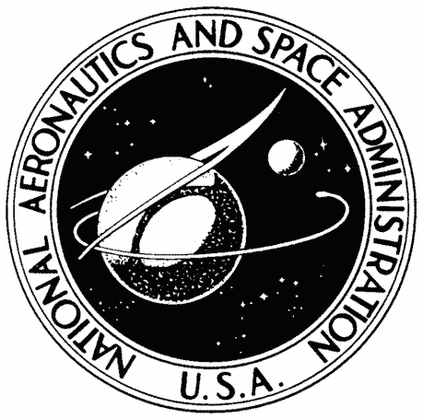

Evaluating MPI Performance and
Scalability in Supercomputing Environments
Morgan Olivia Newton
High-Performance Computing, Code 606.2
NASA Center for Climate Simulation
NASA Goddard Space Flight Center
Summer 2024
Notes:
Hi everyone! Good morning to all the west coasters like me and good afternoon to you east coast folks.
My name is Morgan and I’ll be sharing my work with you today.
My project focused on evaluating MPI performance and scalability in supercomputing environments.
I dare you to say that 5 times fast!

Slide 2
Table of contents
01
02
03
04
05
06
Introduction
Systems and Architecture
Benchmarking
GMAO and GEOS
MPI Performance
Supercomputing Scalability
NASA Center for Climate Simulation (NCCS)
Microsoft Azure and AWS (NCCS)
NASA Advanced Supercomputing (NAS)
Systems Evaluation Overview
OSU Micro-benchmarks
Parameters
MPI Tuning
Setup and Build
Results
Conclusions
Compilation Process
Comparative System Analysis
Challenges
System Performance Metrics
Scalability Findings
Summary
Implications
Future Work
Notes:
In this presentation we will explore GMAO and GEOS, MPI performance, and supercomputing scalability across various systems.
Then, I'll discuss the setup and build process, results, and wrap up with project conclusions and future work.

Slide 3
01
Introduction
GMAO | GEOS
The Global Modeling and Assimilation Office (GMAO) conducts modeling and assimilation activities to support NASA's Earth Observation missions.
The GMAO utilizes data from past missions while aiding in planning
for future missions.
The Goddard Earth Observing System (GEOS) model is key to these activities and consists of multiple components designed for various
Earth Science applications.
The GEOS Earth System Model spans a range of dynamical, physical, chemical, and biological processes.
This study aims to investigate MPI performance anomalies in high-performance computing (HPC) for climate and weather
forecasting, with the goal of optimizing these systems for future use.
Notes:
The Global Modeling and Assimilation Office, or the GMAO, supports NASA's Earth Observation missions by conducting modeling and assimilation activities.
This study investigates MPI performance anomalies in high-performance computing for climate and weather forecasting to optimize future systems.

Slide 4
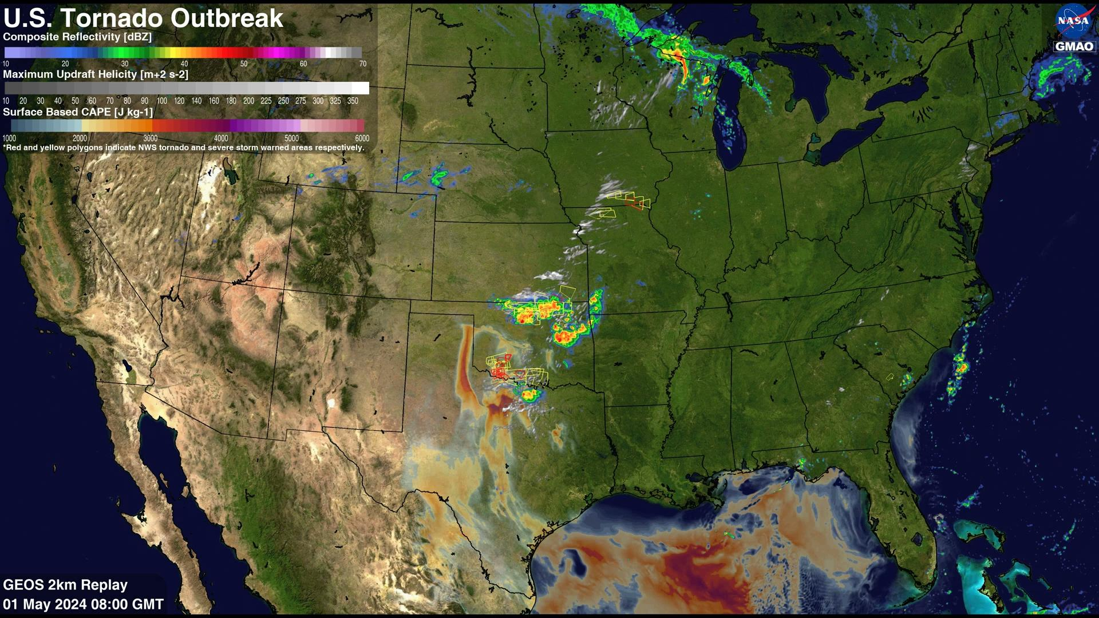
01
Introduction
GMAO | GEOS
Figure 1: GEOS-Exp 2km Severe Weather Modeling Capabilities Highlighted In 2024 HWT Spring Forecast Experiment
Notes:
This example shows a recent experiment where NASA GMAO members Bill Putman and Gary Partyka
joined meteorologists to compare high-resolution weather prediction models in forecasting severe weather across the US.
Neat, huh?

Slide 5
01
Introduction
MPI Performance and Supercomputing Scalability
MPI (Message Passing Interface) is a standard way for different parts of a program to communicate with each other in a supercomputing environment.
When running GEOS models, a significant drop in MPI performance is observed once the number of tasks per node exceeds 64 on AMD Milan architecture.
This performance drop includes significant increases in both latency and elapsed time. OSU Micro-benchmarks were conducted across three different systems to compare MPI performance, specifically focusing on these metrics.
Scalability within supercomputing is crucial as it allows systems to handle larger tasks and more data efficiently, ensuring faster and more accurate simulations and models.
By evaluating MPI performance, areas for improvement in communication efficiency can be identified, enhancing scalability, optimizing resource utilization, and improving overall system performance.
Notes:
MPI is a standard for program communication in supercomputing environments.
When running GEOS models on AMD Milan architecture, MPI performance drops significantly when tasks per node exceed 64, increasing latency and elapsed time.
OSU Micro-benchmarks were used to compare MPI performance across three systems, focusing on these metrics.
By evaluating MPI performance, we can identify areas for improving communication efficiency, enhancing scalability, and optimizing overall system performance.

Slide 6
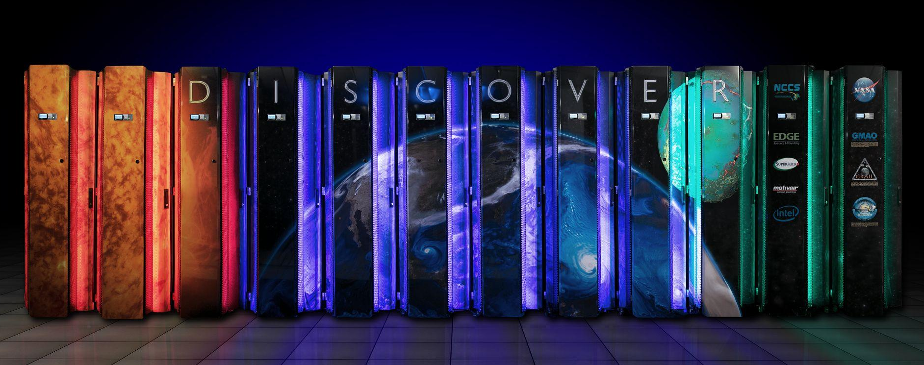
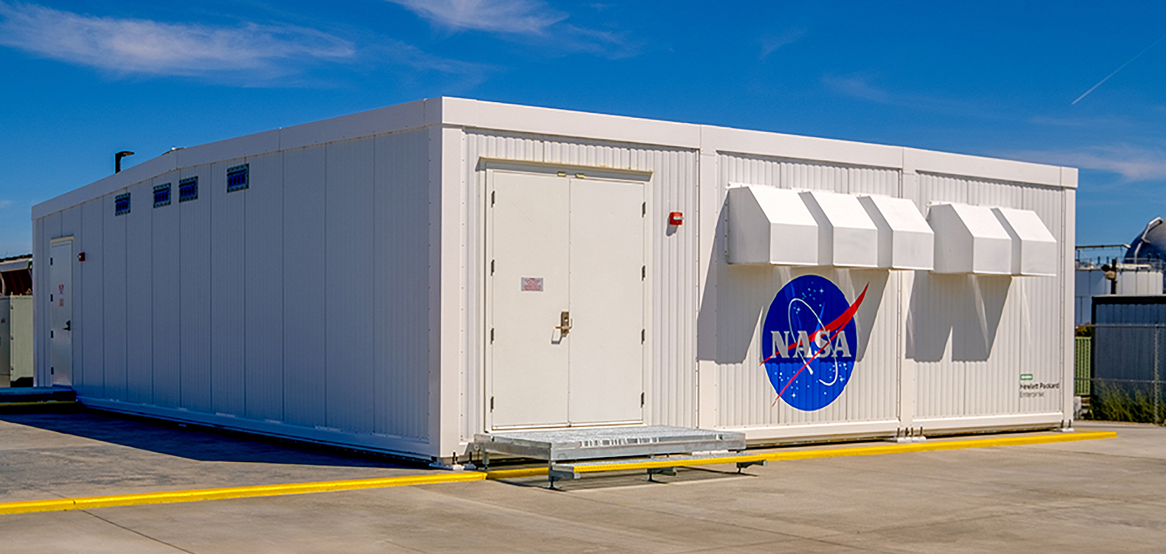
02
Systems and Architecture
NASA Center for Climate Simulation (NCCS)
NASA Advanced Supercomputing (NAS)
The NASA Center for Climate Simulation (NCCS) provides global HPC resources to scientists and researchers.These resources include the Discover supercomputer, a crucial component of NCCS. Discover features several hardware architectures, most notably AMD Milan nodes, which deliver nearly 8.1 petaflops of computational power.
Sponsored by the High-End Computing Capability project, the NASA Advanced Supercomputing (NAS) facility at NASA’s Ames Research Center features three supercomputers: Pleiades, Electra, and Aitken. Aitken, NASA's most powerful supercomputer (10.76 petaflops), is housed in the Modular Supercomputing Facility at Ames.
Notes:
The NASA Center for Climate Simulation, or NCCS, provides global HPC resources,
including the Discover supercomputer with AMD Milan nodes offering nearly 8.1 petaflops of power.
At Ames Research Center, the NASA Advanced Supercomputing facility, or NAS, houses the 10.76 petaflop Aitken supercomputer.

Slide 7
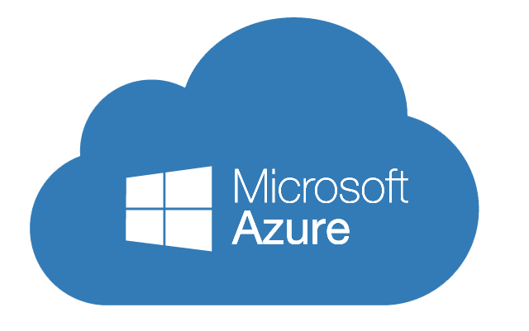

02
Systems and Architecture
Microsoft Azure and Amazon Web Services (AWS)
Science Managed Cloud Environment (SMCE) integrates Microsoft Azure and Amazon Web Services (AWS) to offer scalable cloud computing to users. Both HPC clusters and cloud computing provide access to powerful hardware on demand, but they differ in how users access and manage these resources.
Notes:
Science Managed Cloud Environment (SMCE) integrates Microsoft Azure and Amazon Web Services (AWS) to offer scalable cloud computing to users.
Both HPC clusters and cloud computing provide access to powerful hardware on demand, but they differ in how users access and manage these resources.

Slide 8
02
Systems and Architecture
System Evaluation Overview
A comparative analysis was performed to provide insights into the optimal use of these diverse computing environments for supercomputing tasks, particularly with GEOS climate code.
OSU micro-benchmarks were conducted on Discover, AWS, and Aitken using AMD Milan architecture to compare the
performance and scalability of all three systems.
The comparison included examining the operating systems (OS) used in these environments: NCCS cloud systems Azure and AWS run on Ubuntu, NAS Aitken operates on Red Hat Enterprise Linux (RHEL), and NCCS Discover uses SUSE Linux Enterprise Server (SLES).
This analysis aimed to identify any performance variances due to the underlying operating systems.
Notes:
A comparative analysis was conducted to optimize the use of different computing environments for supercomputing tasks with GEOS climate code.
OSU micro-benchmarks on Discover, AWS, and Aitken using AMD Milan architecture compared performance and scalability, examining the impact of operating systems:
Azure and AWS on Ubuntu, Aitken on Red Hat, and Discover on SLES.

Slide 9
03
Benchmarking
OSU Micro-benchmarks
The OSU (Ohio State University) Micro-benchmarks are a suite of tests
used to evaluate the performance of MPI. These benchmarks measure latency, bandwidth, multiple-bandwidth, and message rates.
They are essential tools for identifying performance bottlenecks and
comparing different systems, interconnects, and MPI implementations.
In our study, we used benchmarks osu_allgather, osu_allgatherv, osu_allreduce, osu_barrier, osu_bcast, osu_gather, osu_gatherv, osu_reduce, osu_reduce_scatter, osu_scatter, and osu_scatterv.
MPI allgather and allgatherv operations face three scaling limits:
small word injection limit (the rate of small message injection), injection bandwidth limit (the maximum data transfer rate), and network bisection limit (the maximum throughput the network can handle when evenly split).
These limits cause congestion and decreased performance as messages
and core counts increase.
Notes:
The OSU Micro-benchmarks evaluate MPI performance, measuring latency, bandwidth, and message rates to identify bottlenecks.
We gathered various benchmark data but primarily focused on allgather and allgatherv. These benchmarks face scaling limits like small message injection rate,
injection bandwidth, and network bisection, causing congestion and decreased performance with more messages and cores.

Slide 10
03
Benchmarking
MPI Tuning
Parameters
MPI tuning consists of several configurations designed to optimize communication performance by tailoring configuration settings
to specific workloads.
I. No Tuning
Uses default MPI settings without any added adjustments.
II. OFI Tuning
Involves setting the environment variable I_MPI_FABRICS=ofi.
Utilizes OpenFabrics Interfaces for efficient inter-node communication.
III. GMAO + OFI Tuning
Uses I_MPI_FABRICS=ofi and incorporates additional environment variables to enhance performance developed by the GMAO.
IV. GMAO + SHM + OFI Tuning
Uses I_MPI_FABRICS=shm:ofi to combine shared memory (shm) and OFI for communication.
All systems used constant parameters with minor deviations
based on version and architecture availability.
Three sets of runs were conducted and analyzed with varying message sizes (Note: AWS had a 96 tasks per node restriction):
Tuning evaluations: 8192 message size for all systems
Message size evaluations: 2048, 4096, 8192 message sizes
Operating System evaluations: 8192 message size for all systems
Operating System | SLES, Ubuntu, Red Hat
Compiler | GCC 12.3
MPI | MPI 2021.13
Message Size | 8192
nodes : tasks per node | 50:2, 50:4, 50:8, 50:16, 50:32, 50:46, 50:64, 50:96, 64:96, 50:126, 64:126
Notes:
We used several MPI tuning configurations to optimize communication performance.
Consistent parameters across all systems were maintained, with minor deviations based on architecture.
Evaluations focused on tuning, message size variations, and operating systems.
Node and task configurations varied, with a 96 tasks per node restriction on AWS.

Slide 11
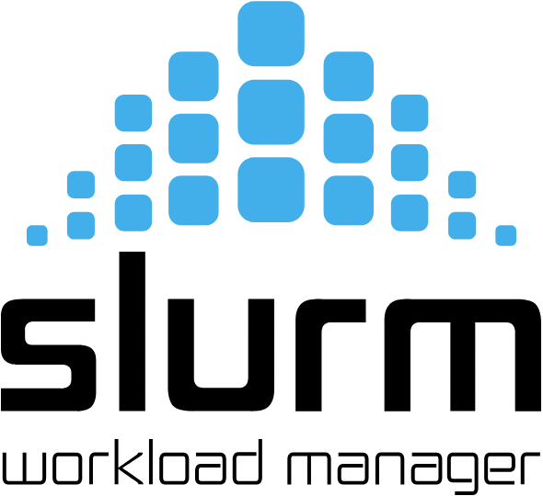
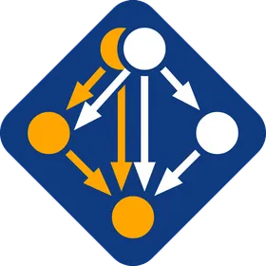
04
Setup and Build
Compilation Process
Compiling across each system involved accessing each
environment via SSH, transferring and extracting necessary
files, allocating resources, loading GCC and MPI modules, and configuring the build environment with appropriate compilers. Benchmarks were compiled using parallel
jobs, and all steps were documented in Confluence to
streamline future work.
Comparative System Analysis
All four systems utilized unique hardware and software configurations, leading to slight variations in MPI performance. While Discover and AWS use Slurm for workload management, NAS uses PBS, with Discover employing traditional software modules and Cloud systems relying on the Spack package manager for a more customizable approach.
Notes:
Compiling across each system involved accessing environments via SSH, transferring files, allocating resources,
loading compiler and MPI modules, and configuring the build environment with the right compilers.
Benchmarks were compiled using parallel jobs, and all steps were documented in Confluence for future work.
All four systems had unique configurations, causing slight variations in MPI performance.
Discover and AWS use Slurm, NAS uses PBS, and Cloud systems use Spack for customization.

Slide 12
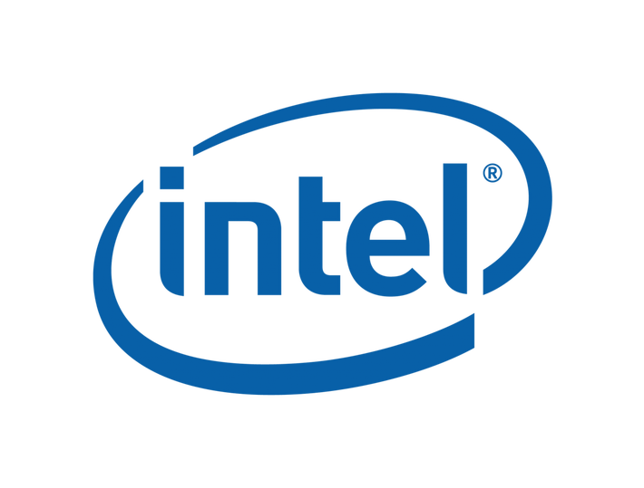
04
Setup and Build
Challenges
NAS
On NAS, PBS presented significant challenges requiring conversion of the sbatch command into a qsub command. Several unique flags also needed to be added to correctly convert to the new system.
PBS only provided an environment variable for tasks per node and lacks variables for nodes and
total tasks. To account for this inconsistency, custom variables were built. These manual
adjustments enabled build scripts to function accurately on the new system.
Azure
Azure required a customized Spack environment for the necessary compiler and MPI
versions, but using Intel MPI caused a system-wide issue where jobs would hang without
error information, necessitating escalation to senior engineers and Intel experts.
This bug discovery is beneficial but has paused progress with Azure.
AWS
Navigating AWS posed challenges, including resource allocation issues and manual increases in usage limits, with tasks per node adjusted to 96 due to system architecture. Segmentation faults during benchmarks were traced to the '-x' flag associated with the benchmark. The ‘-x’ flag is used to denote which iteration to start gathering data from, typically set to 1 to ensure that no warm-up iterations are skipped. The root cause of the problem remains unclear, but removing the ‘-x’ flag from the script resolves the issue.
This adjustment may affect performance measurement accuracy by omitting startup costs.
Notes:
On NAS, converting the sbatch command to qsub for PBS presented challenges, requiring unique flags and custom variables.
PBS only provided environment variables for tasks per node, so custom variables were built for nodes and total tasks.
Azure required a customized Spack environment for compilers and MPI versions, but Intel MPI caused jobs to hang without any error information,
ultimately leading to seeking out help from senior engineers and Intel experts. This bug discovery is beneficial but has paused progress with Azure.
Navigating AWS posed challenges as well. Various errors were traced to the '-x' flag associated with the benchmark.
The ‘-x’ flag is used to denote which iteration to start gathering data from, typically set to 1 to ensure that no warm-up iterations are skipped. We want ALL the data!
The root cause of the problem remains unclear, but removing the ‘-x’ flag from the script resolves the issue for now.
This adjustment may affect performance measurement accuracy by omitting startup costs.

Slide 13
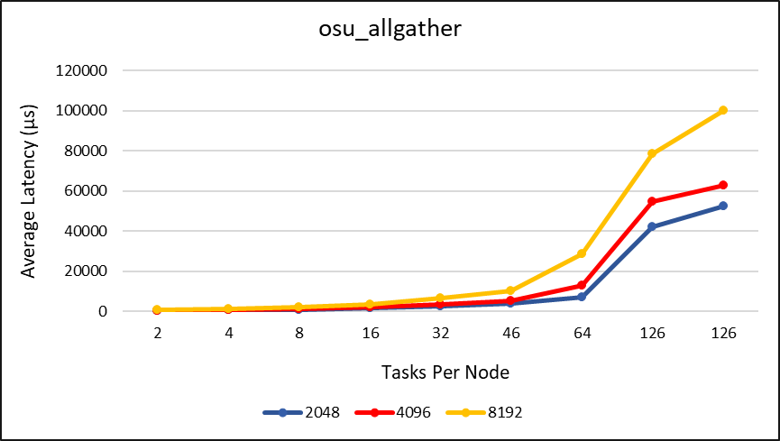
05
Results
Scalability Findings
Curiously…
2048 and 4096 show potential leveling off in average latency at around 60,000 μs, suggesting that the impact on latency may stabilize at higher ranks.
Figure 2: OSU Allgather Benchmark: Average latency increases significantly across all message sizes after 64 tasks per node on Discover Milan architecture for message sizes 2048, 4096, and 8192.
Notes:
This figure shows the allgather benchmark on Discover Milan architecture.
Average latency increases significantly after 64 tasks per node for all message sizes.
Notably, latencies for 2048 and 4096 level off around 60,000 microseconds, suggesting possible stabilization at higher ranks.

Slide 14
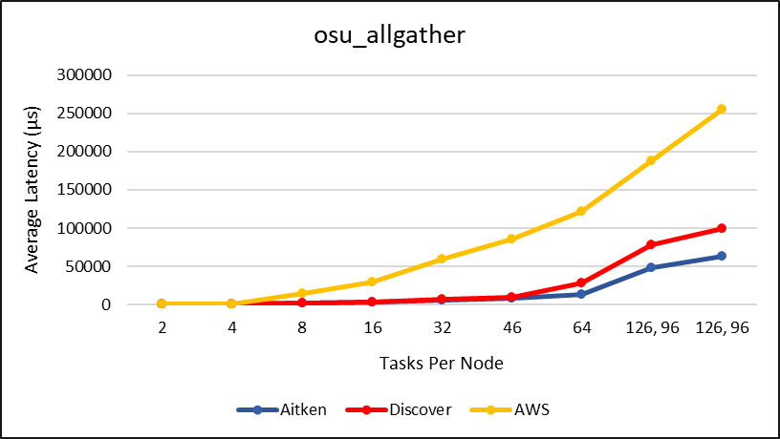
06
Conclusions
Operating system evaluation of Discover (SLES), AWS (Ubuntu), and Aitken (Red Hat) showed no significant performance differences in increasing average latency.
A consistent average latency increase across systems with more than
64 tasks per node confirms issues are not due to operating system anomalies.
Despite latency increases, Aitken demonstrated better scalability and lower average latency in allgather and allgatherv benchmarks. Aitken performed twice as well as Discover with higher configurations (126 tasks per node).
Notes:
Operating system evaluation of Discover, AWS, and Aitken showed no significant performance differences in increasing average latency.
In other words, this increase we see across all systems confirms issues are not due to operating system anomalies.
Despite latency increases, Aitken demonstrated better scalability and lower average latency.
Aitken performed twice as well as Discover with higher configurations.

Slide 15
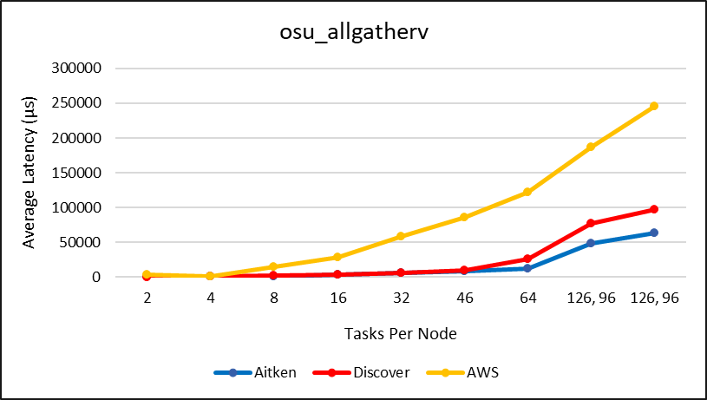
06
Conclusions
AWS showed a concerning increase in average latency as tasks per node increased.
We expected better performance due to omitted startup iterations and
lower task limits (96 tasks per node), yet the results indicate otherwise.
Important Note!
AWS's use of Ethernet may adversely affect MPI performance compared to InfiniBand on Discover and Aitken.
Notes:
AWS showed a concerning increase in average latency as tasks per node increased.
We expected better performance due to omitted startup iterations and lower task limits, yet the results indicate otherwise.
It’s worth mentioning, AWS's use of Ethernet may adversely affect MPI performance compared to InfiniBand on Discover and Aitken.

Slide 16
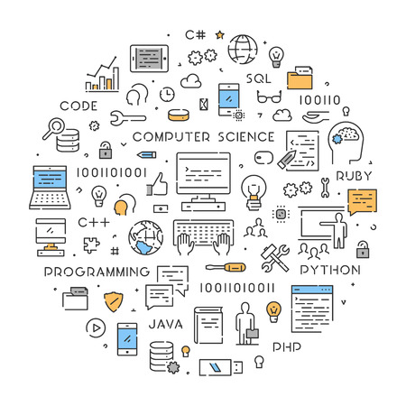
06
Conclusions
Why does this research matter?
The implications of this work are crucial for supercomputing and directly benefit the
GMAO and NCCS.
By confirming that operating system differences do not significantly impact performance, the research eliminates one potential variable in optimizing supercomputing environments.
This research also helps software developers refocus their efforts on their MPI approach.
Additionally, the validated methodology for assessing the impact of operating systems can be applied to future studies and evaluations, fostering more efficient and effective research.
Notes:
The implications of this work are crucial for supercomputing and directly benefit the GMAO and NCCS.
By confirming that operating system differences do not significantly impact performance, the research eliminates one potential variable in optimizing supercomputing environments.
Additionally, this method for assessing the impact of operating systems can be used in future studies, promoting more efficient and effective research.

Slide 17

References
Acknowledgments
NASA Center for Climate Simulation (NCCS). Retrieved from https://www.nccs.nasa.gov.
NASA Scientific and Mission Computing Environment (SMCE). Retrieved from https://www.smce.nasa.gov.
NASA Advanced Supercomputing (NAS) Division. Retrieved from https://www.nas.nasa.gov.
Laura Carriere
Bruce Pfaff
William Woodford
Nicko Acks
Hoot Thompson
Matt Thompson
Notes:
Here are my references to note and some folks I’d love to acknowledge for all the great help I received throughout the summer.
Laura, Bruce, Bill, Nicko, Hoot, and Matt -
I am endlessly grateful for all of your guidance, patience and insight. THANK YOU!

Slide 18








Questions?!
If anyone has any
questions, please
contact me!
morgan.o.newton@nasa.gov
morganoliviaevans@gmail.com
Notes:
If anyone has any questions, please don’t hesitate to contact me!
And if anyone wants to connect on Linkedin, grab your phone super quick and scan away!
Thank you for your time today!

